Slide 1

Last Unit!!!
Unit 11 – Correlation and Regression
Your Ready-to-be-done-with-slides Professor Colton

Slide 2
Unit 11 - Outline
Unit 11 – Correlation and Regression
Intro
Correlation Coefficient (r)
Testing for Significant Linear Correlation

Slide 3
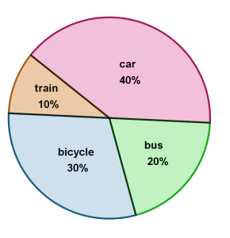
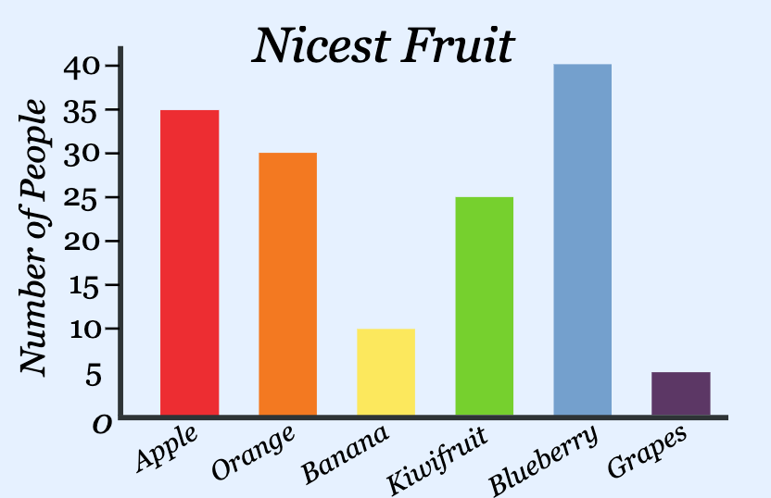
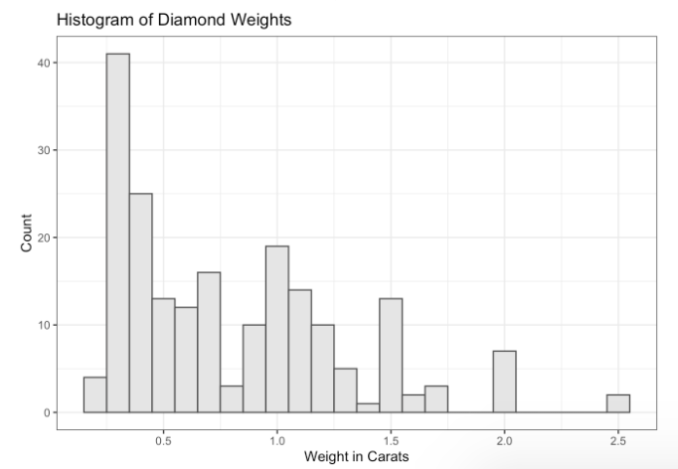
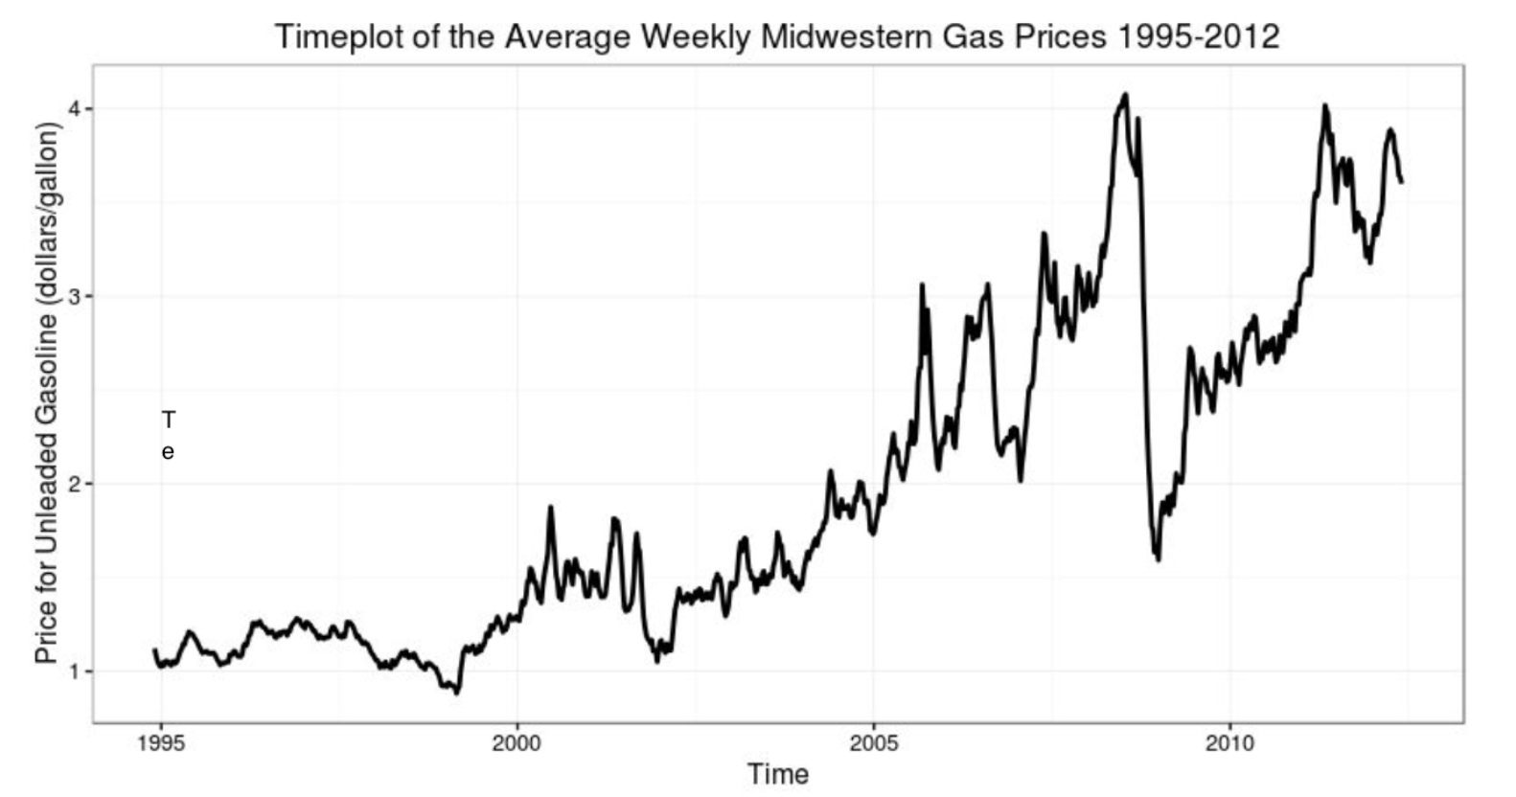
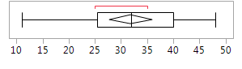
Review + New
We have studied how to display and describe distributions depending on the type of data
Qualitative (Categorical) Data
Non-Numerical data with different categories.
Ex) States, letter grades, class standing, etc.
Here we can describe the mode (the most common category)
Quantitative Data
Numerical data, counts or measurements
Arithmetic operations such as adding and averaging make sense
Ex) Income, GPA, Height, Weight, etc.
With line graphs (time series plots), we described the trend and seasonal variation
With histograms and boxplots, we described the SOCS! Shape, Outliers, Center and Spread
Also numerical summaries like mean, median, SD, IQR, etc.
(Other than the line graph) these displays were all for ONE variable!
Now we are going to display and describe the relationship between TWO QUANITITATIVE variables!

Slide 4
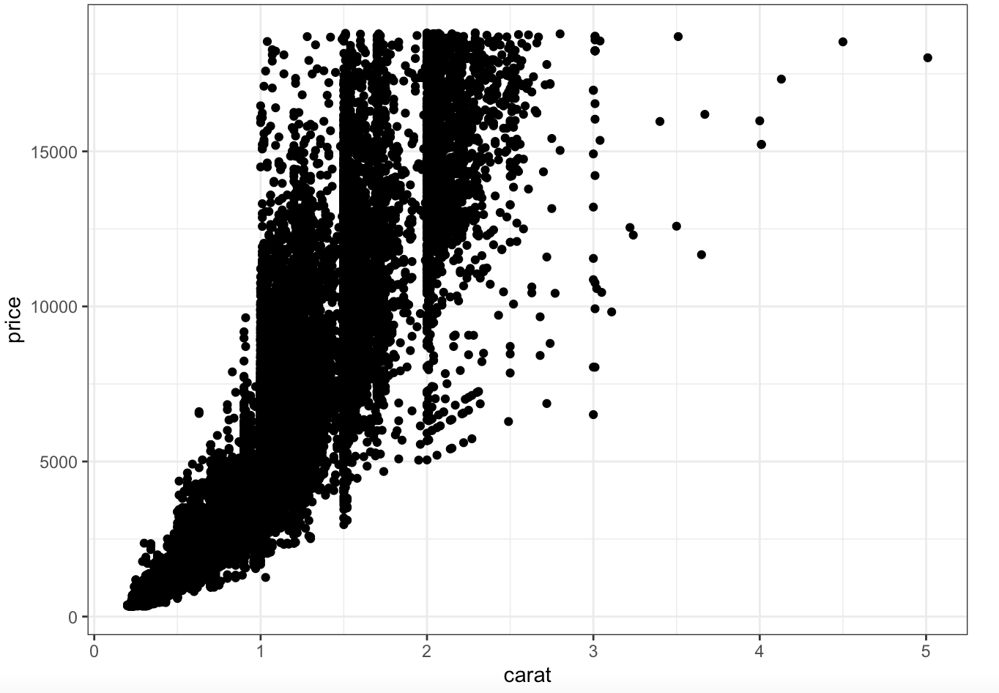
Scatterplots
Scatterplot
Displays the relationship between two quantitative variables measured on the same individuals.
Useful to determine if an association exists!
So is there a pattern where some values of one variable tend to occur with some values of the other variable
Example) Smaller carat diamonds tend to have lower prices, and as the carat increases prices tend to increase as well
In some situations, such as experiments or studies, we want to see if one variable explains the variability of the other.
Can we use one variable to predict the other?
Example) If I have a 2.5 carat diamond, how much will it cost?
Setup
Axes
The explanatory (independent) variable goes on the X (horizontal) axis
The response (dependent) variable goes on the Y (vertical) axis
Example) How large a diamond is impacts how much it costs! So the price would be the dependent (Y) and carat independent (X)
If there is no clear explanatory/response relationship, then it does not make a difference which variable goes on which axis.
Points
Every individual in the data set has two measurements, one for each variable, and each individual appears as a dot on the plot.
Every point is an ordered pair (x,y)

Slide 5
LCQ – Explanatory vs Response
Problem: Determine which variable would go on the X-axis and the Y-axis of the scatterplot → It is important to get this correct because it will impact the analyses we will learn later!!
Strategy→ Think in terms of dependent and independent variables (response vs explanatory) ; or maybe chronologically, which comes first)
The amount of time spent studying for an exam and the exam score
X = Time spend studying → Chronologically, you study before the exam. So this would be the independent
Y = Exam score → Exam score definitely depends on the amount of time you spend studying
The weight and height of a person
X = Height → In general (overall), we can say that the height of someone helps determine their weight (the taller, the more weight) so it would come first
This pattern might not always be true, but in general we can say this
Y = Weight
The amount of yearly rainfall and crop yield
X = Amount of yearly rainfall
Y = Crop yield → This definitely depends on the amount yearly rainfull, so it would be on the Y-axis
A student’s math SAT score and the verbal SAT score
X = either or
Y = the other one
For this one there is no clear explanatory vs response. Can’t really say that math score depends on verbal score or vice versa.
So we can choose which goes where, both would be correct

Slide 6
Interpreting Scatterplots
Just like there was a specific way we describe the SOCS of histogram for example, there are certain aspects that we look for when interpreting the relationship between two variables in a scatterplot.
Overall Patter of a Scatterplot
We can describe the overall pattern of a scatterplot by looking at four characteristics:
Form
Direction
Strength
Outliers

Slide 7
Form
Form
This refers to the pattern of the dots
Or we can think about it as the “best” type of line that we could draw to the data, if any
Imagine trying to draw a line that tries to go through the middle of all the data as best as possible, and maybe “bands” that surround the data
It might not be super clear every time, so we are just looking in general!
Remember, we are trying to describe the relationship between our two variables, this is the GOAL!
There are three types of forms we will consider:
Linear
Points are following a general linear trend → Straight line
Note that it won’t be perfect, but a general linear trend is what we are looking for here
A linear relationship occurs quite frequently in the real world
Curved
Points are showing some evidence of curvature
NOT a straight line → Any type of CLEAR curvature in the “best” line we could
Random scatter
There really is no pattern, points are just scattered about randomly kinda like a cloud of points

Slide 8
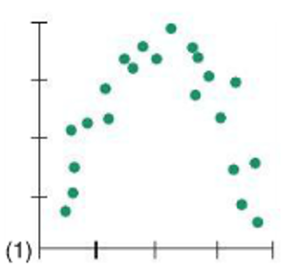
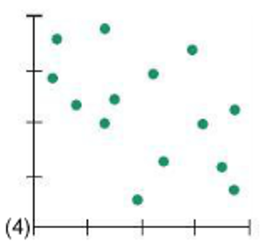
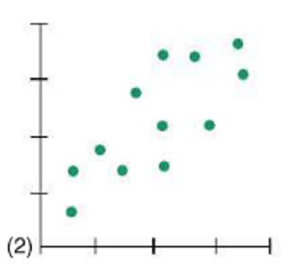
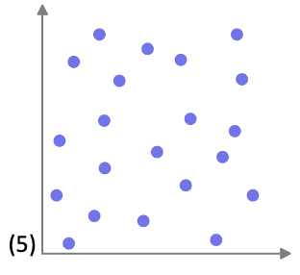
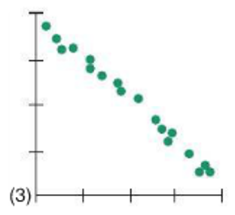
LCQ: Form
Problem: Determine the form for each of the following scatterplots.

Slide 9


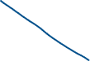
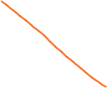
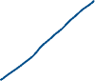
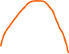
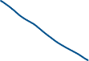



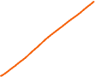
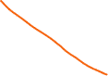

LCQ: Form
Problem: Determine the form for each of the following scatterplots.
Curved → CLEAR curvature if we draw that line through the middle and if we trace the lower and upper edges
Curvature can also look like these where it kinda levels off, it doesn’t have to be the full rainbow
Linear → for the most part follows the straight diagonal line through the middle
Linear → dots more clearly follows a linear path
Linear-ish → not perfect ( or as clear as the others), but these dots generally follow straight line path with the middle and outside lines
Random → there is no patter here, just scattered everywhere

Slide 10
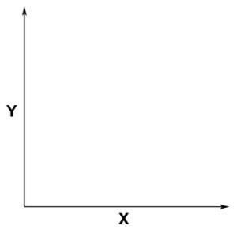
Direction
Direction
This refers to the direction of the association between the two variables
** This only applies to linear relationships as curved patterns can have both positive and negative directions in the same scatterplot, and random relationships are neither entirely positive or negative.
We can think of this as the slope of our line!
Positive Association
High values of one variable correspond (tend to occur with) to high values in the other variable, and
Low values of one variable correspond to low values in the other variable
So as the values of X increase, the values of Y tend to increase as well → Positive slope!
Variables are moving in the same general direction
Negative Association
High values of one variable correspond (tend to occur with) to low values of the other and vice versa
So as the values of X increase, the values of Y tend to decrease → Negative slope!
Variables are moving in the opposite general direction
No Association
There is no pattern or general trend
Low values of one variable can have both high or low values of the other; high values of one variable can have both high or low values of the other
Knowing if we have a high or low value of one variable gives us no indication whether the other variable’s value will be high or low
+
—

Slide 11
LCQ: Direction
Problem: Determine the direction for each of the following scatterplots.

Slide 12
LCQ: Direction
Problem: Determine the direction for each of the following scatterplots.
Starts positive, then goes negative; Not applicable → If we divide this plot in two, there are two different associations! This is because of the curved form.
We are only going to apply direction to linear forms, so this wouldn’t fit
Positive → definitely a positive slope to the “best” line we could draw. And we see the points shifting in the same direction, both increasing together
Negative → clear negative slope, Ys decrease as Xs increase (opposite directions
Positive → Still a positive slope to the line through the middle of the points
No association → there is no clear shift in the positive or negative direction, points kinda stay flat
It turns out the “best” line that we can draw here is a horizontal line cutting them in half, which would have a slope of zero!
We can think of no association as a slope of zero

Slide 13
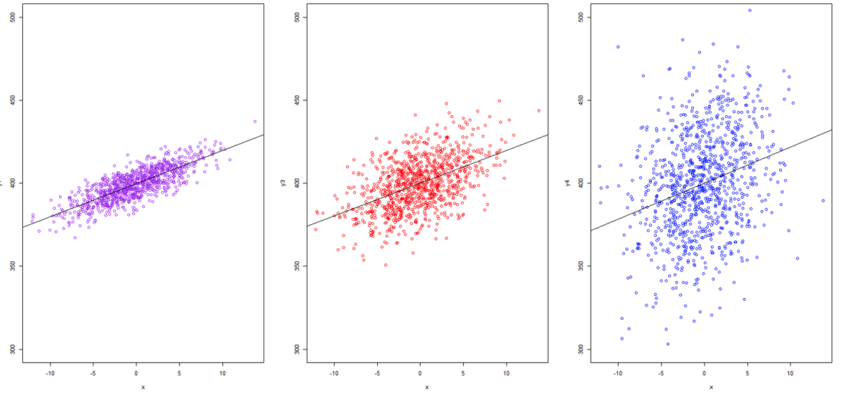
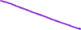

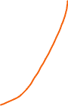

Strength
Strength
This refers to how strong the association is
In other words, how well the data fits the pattern?
We can think of this as how CLOSE the data are to our “best” line (the form)!
So how small or large the spread is around our “best” line
To visualize this, we can draw ovals centered on our “best” line that capture the majority of the points
Then look at how wide the oval is in the center perpendicular to the “best” line
** We are ONLY going to apply this to linear relationships
We are going to classify strength in three categories:
Larger spread
Smaller spread
High Strength (Strong)
The dots follow the linear pattern closely, with little scatter
Relatively small width of our oval
Moderate Association
The dots follow a general pattern, but not as tightly packed
Relatively medium width of our oval, still looks like an oval
Low Strength (Weak)
The dots do not appear to be following a pattern
Relatively large width of our oval, which starts looking more like a circle
https://bookdown.org/yshang/book/correlation.html

Slide 14
LCQ: Strength
Problem: Determine the strength for each of the following scatterplots.

Slide 15

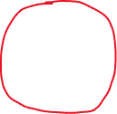
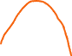

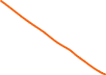



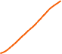

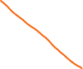

LCQ: Strength
Problem: Determine the strength for each of the following scatterplots.
Starts, but not applicable → Points definitely follow this pattern very well, indicating a high strength. But because it has a curved form, we are not going to apply our definition of strength
Moderate → Fairly smallish width of our oval, not too much spread around the “best” line
Strong → very small spread around the “best” line. Points follow this pattern very closley
Moderate, maybe weak → medium-ish width of our oval. Hard to determine whether it would be moderate or weak. But
definitely weaker than (2),
Super weak→ almost have a circle / rectangular-ish shape here because of the lack of association, very large spread too

Slide 16
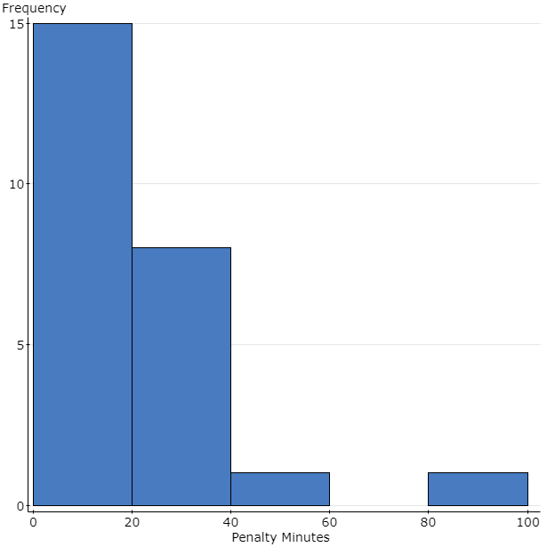
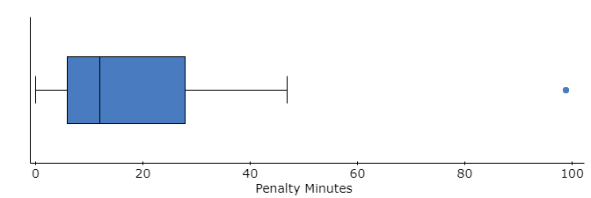
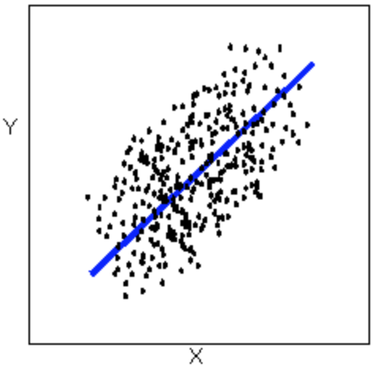
Outliers
Outliers
Outliers are points that do not follow (deviate from) the overall / general pattern
Recall outliers from histograms and boxplots
Now we have two variables, so points can be an outlier in several different ways:
Only in the X direction → meaning the Y values are within the normal range, but the Xs are too different
Only in the Y direction → X values are within the normal range, but the Ys are too different
In both directions → Both X and Y are way different
This one and the upper right corner are at least in the path if we extend the best line, the other orange outliers are VERY different than the all other points
https://bolt.mph.ufl.edu/6050-6052/unit-1/case-q-q/scatterplots/

Slide 17
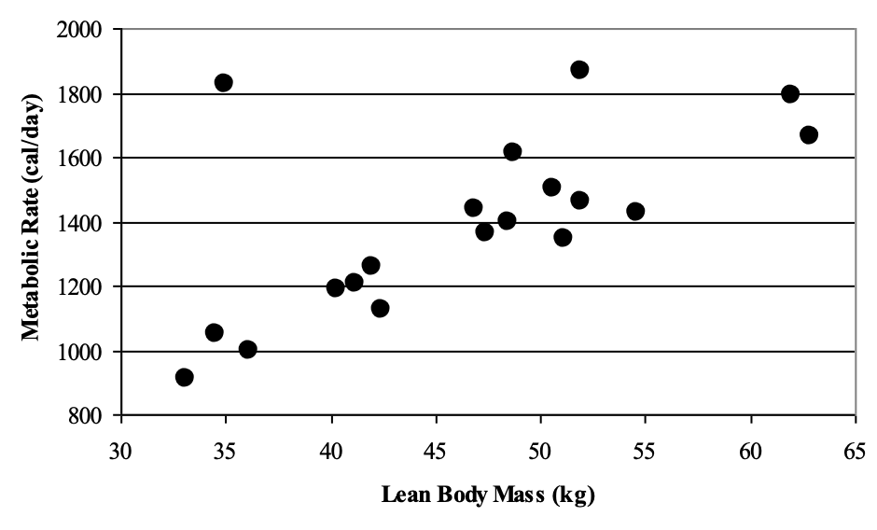
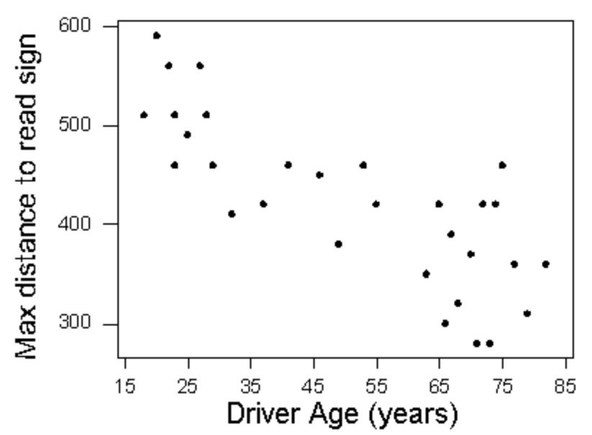
LCQ: Interpreting Scatterplots
Problem: Interpret the following scatterplots by discussing their Form, Direction, Strength and Outliers
a)
b)
https://courses.lumenlearning.com/wmopen-concepts-statistics/chapter/scatterplots-3-of-5/

Slide 18
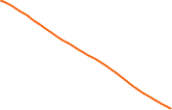





LCQ: Interpreting Scatterplots
Problem: Interpret the following scatterplots by discussing their Form, Direction, Strength and Outliers
a)
All 4 pieces:
Linear form, positive direction, moderate (strong?) strength, appears to be at least one outlier
If we wanted to write this interpretation in a nice sentence with context, it could go like this:
There is a positive, moderate strength, linear relationship between lean body mass and metabolic rate. There appears to be one outlier at ≈ (35, 1850)
All 4 pieces:
Linear form, negative direction, moderate strength, and does not appear to be any outliers
If we wanted to write this interpretation in a nice sentence with context, it could go like this:
There is a negative, moderate strength, linear relationship between drivers age and max distance to read sign. There does not appear to be any outliers
b)
https://courses.lumenlearning.com/wmopen-concepts-statistics/chapter/scatterplots-3-of-5/

Slide 19
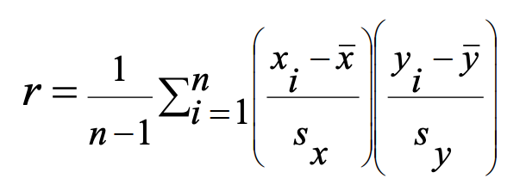
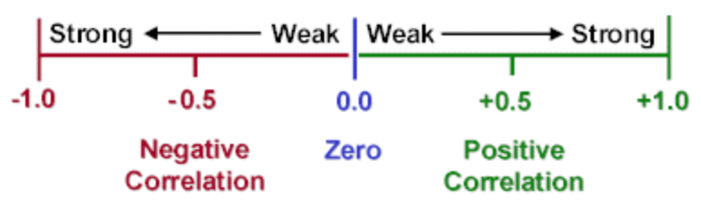
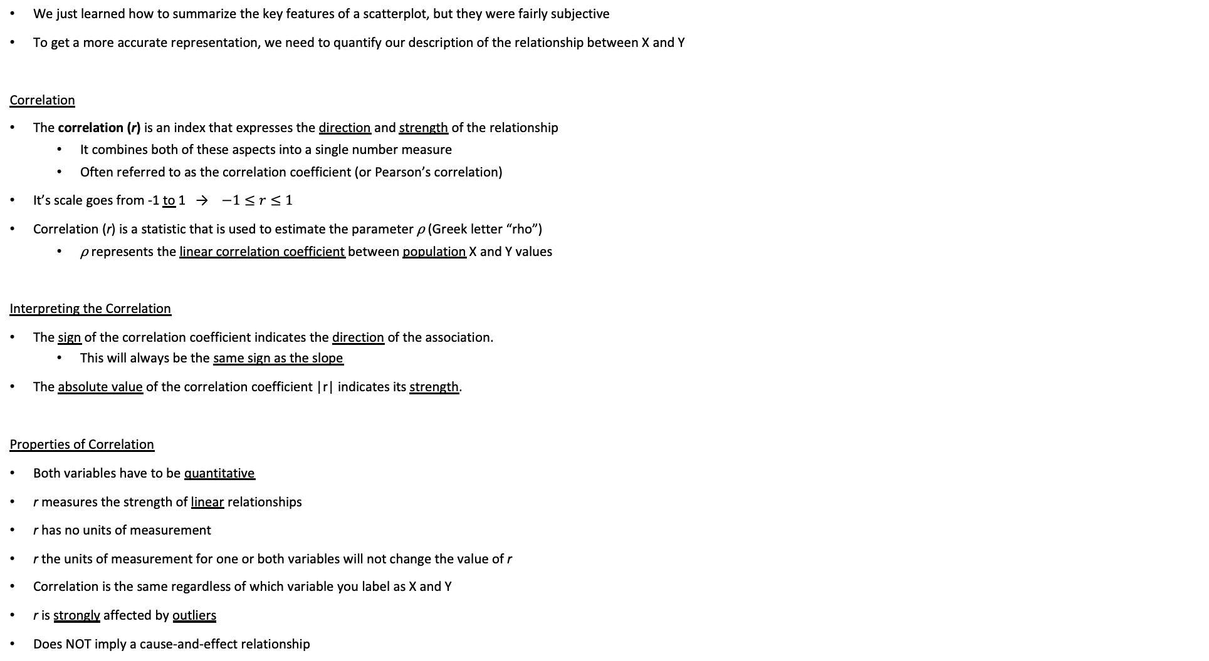
Correlation
We just learned how to summarize the key features of a scatterplot, but they were fairly subjective
To get a more accurate representation, we need to quantify our description of the relationship between X and Y
Correlation
The correlation (r) is an index that expresses the direction and strength of the relationship
It combines both of these aspects into a single number measure
Often referred to as the correlation coefficient (or Pearson’s correlation)
It’s scale goes from -1 to 1 → $−1≤r≤1$
Correlation (r) is a statistic that is used to estimate the parameter ⍴ (Greek letter “rho”)
⍴ represents the linear correlation coefficient between population X and Y values
Interpreting the Correlation
The sign of the correlation coefficient indicates the direction of the association.
This will always be the same sign as the slope
The absolute value of the correlation coefficient |r| indicates its strength.
Properties of Correlation
Both variables have to be quantitative
r measures the strength of linear relationships
r has no units of measurement
r the units of measurement for one or both variables will not change the value of r
Correlation is the same regardless of which variable you label as X and Y
r is strongly affected by outliers
Does NOT imply a cause-and-effect relationship
Formula
In words, we could describe this formula as an “average” of the product of the standardized values of the two variables.
Our calculator will do this for us!

Slide 20
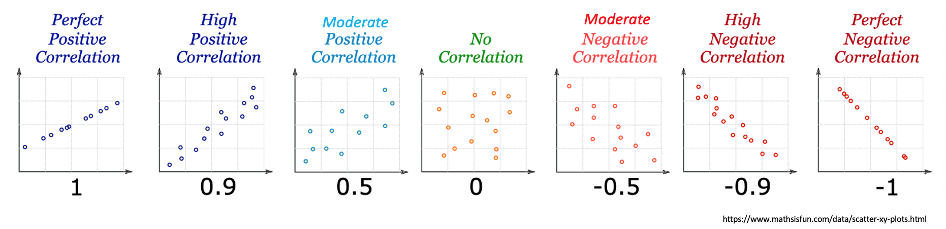
Correlation Visually
With perfect correlations, there is an EXACT equation describing the data: such as Y = 10 – 2X
If I know X, I automatically know where Y is going to be
As we decrease the strength of the correlation, there more and more uncertainty is introduced.
So maybe the equation becomes Y = 10 – 2X ± 1 and then decrease again and it becomes Y = 10 – 2X ± 3
Until ultimately as the correlation gets very close to zero, knowing X gives me no knowledge about Y

Slide 21
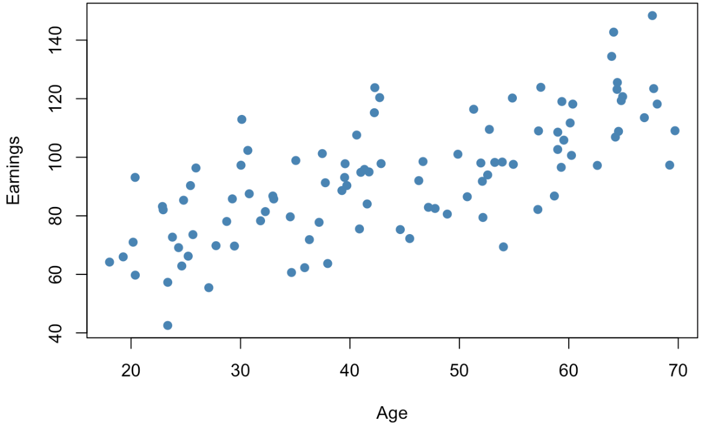
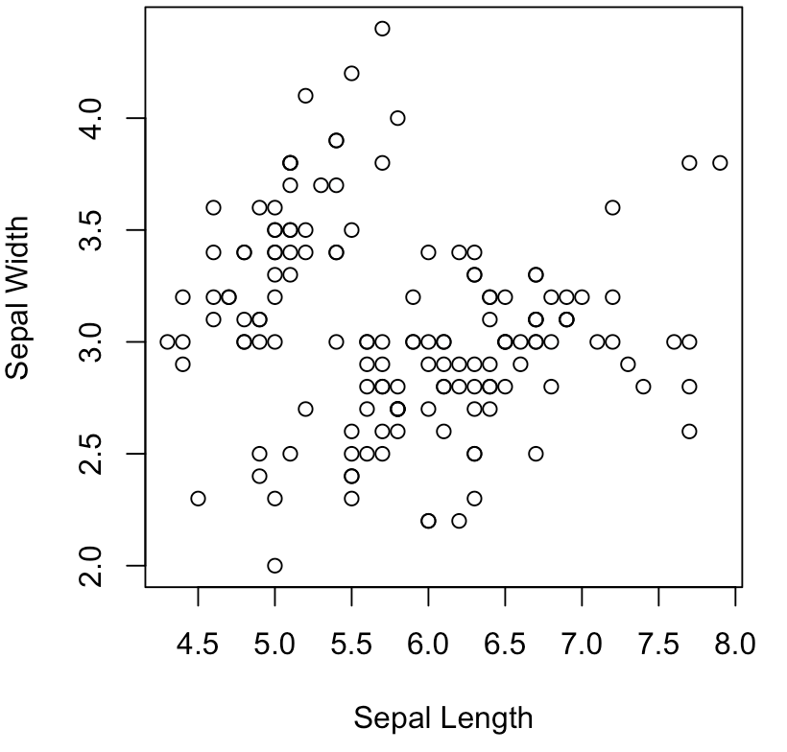
LCQ: Interpreting Correlation
How to Interpret Correlation
Have to mention the magnitude (which refers to the strength of linear relationship between X and Y) and direction (+/-)
And USE CONTEXT!!!
General structure → There is a < strong, moderate, weak >, < positive / negative > linear relationship between X and Y
Problem: Interpret the correlations for the each of the following scatterplots
a)
https://www.econometrics-with-r.org/3-7-scatterplots-sample-covariance-and-sample-correlation.html
b)
r = 0.706
r = -0.12

Slide 22
LCQ: Interpreting Correlation
How to Interpret Correlation
Have to mention the magnitude (which refers to the strength of linear relationship between X and Y) and direction (+/-)
And USE CONTEXT!!!
General structure → There is a < strong, moderate, weak >, < positive / negative > linear relationship between X and Y
Problem: Interpret the correlations for the each of the following scatterplots
a)
https://www.econometrics-with-r.org/3-7-scatterplots-sample-covariance-and-sample-correlation.html
b)
r = 0.706
r = -0.12
Options
1) There is a moderate, positive linear correlation between x and y → MISSING CONTEXT!!! Use the variable names at least
2) There is a moderate, positive linear correlation (relationship) between age an earnings → PERFECT now! Could also say ‘linear relationship’ instead of ‘correlation, both would be correct!
There is a weak, negative linear correlation between Sepal Length and Sepal Width → Remember the direction is based off the sign of the correlation and the strength is based on the magnitude (refer to the guidelines in the table!

Slide 23
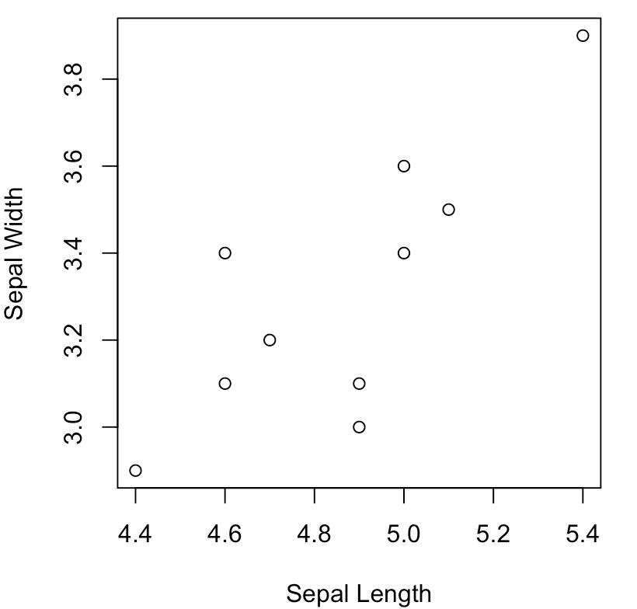
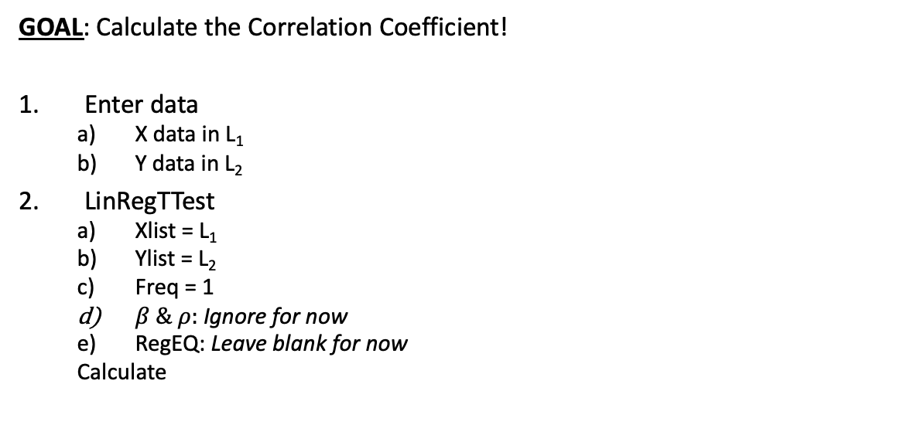
Using Calc - Correlation
GOAL: Calculate the Correlation Coefficient!
Enter data
X data in L₁
Y data in L₂
LinRegTTest
Xlist = L₁
Ylist = L₂
Freq = 1
$β \& ρ:$Ignore for now
RegEQ: Leave blank for now
Calculate
X Y
New point
Outliers Demonstration
Let’s change one data point to see the effects on the correlation:
9th observation: (4.4, 2.9) → (4.4, 3.8)
Now recalculate the correlation!

Slide 24
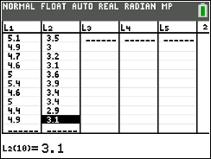
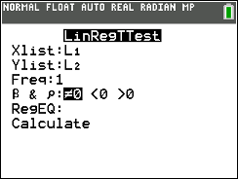
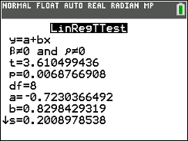
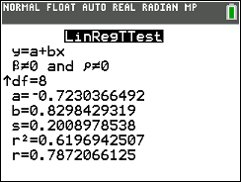
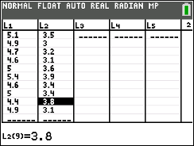
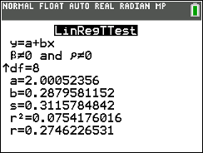
Using Calc - Correlation
r = 0.787
GOAL: Calculate the Correlation Coefficient!
Enter data
X data in L₁
Y data in L₂
LinRegTTest
Xlist = L₁
Ylist = L₂
Freq = 1
$β \& ρ:$Ignore for now
RegEQ: Leave blank for now
Calculate
Impact on Correlation
Changing one point decreased the correlation by 0.512 (which is slightly more than a quarter of the total scale (total range is from -1 to 1, length 2)
This illustrates how sensitive the correlation can be, especially with small sample sizes
X Y
r = Correlation
This is the only output we need for now!
New point
r = 0.275
Outliers Demonstration
Let’s change one data point to see the effects on the correlation:
9th observation: (4.4, 2.9) → (4.4, 3.8)
Now recalculate the correlation!

Slide 25
Test for a Linear Relationship via Correlation
Test for a Linear Relationship
In order to test for a significant linear relationship between two quantitative variables, we can do a test on the correlation
Recall Correlation measures the strength of a LINEAR relationship
So if the correlation is large enough in magnitude, we can conclude that a linear relationship is indeed present
If we have a linear relationship between our independent and dependent variable, we can estimate our “best” line and use that to make predictions!
This is ultimate goal!
Process
Before we run our test, we have to look at the scatterplot!
* This is kinda going to be our assumption for this test! (along with having a random sample two quantitative variables! Although we won’t have to mention these)
We are looking for the form!
If the data look at all linear, then we can conduct a hypothesis test using the same procedures we have learned before

Slide 26
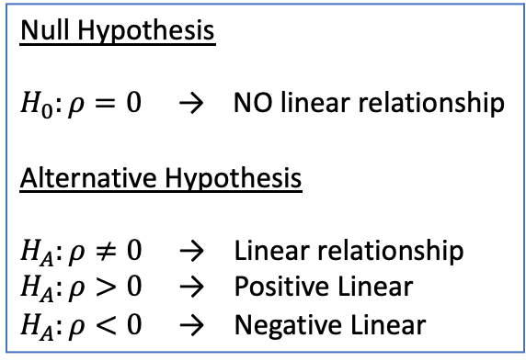
Hypotheses
Logic
This is pretty much the SAME thing that we have been doing with Hypothesis Tests for Proportions and Means
Except now we are studying a different parameter ⍴!
Recall ⍴ represents the linear correlation coefficient between population X and Y values
Hypotheses
Null Hypothesis → We always start by assuming ⍴ = 0
There not a significant linear correlation, which means there is NOT a linear relationship between our X and Y variables
Alternative Hypothesis → Then we are trying to show the opposite, that ⍴ does not equal zero
There is a significant linear correlation, which means that that there actually is a linear relationship!
We can be more specific if we want and try to show that there is specifically a positive or specifically a negative linear correlation as well!
Null Hypothesis
$H_{0}:ρ=0$ → NO linear relationship
Alternative Hypothesis
$H_{A}:ρ≠0$ → Linear relationship
$H_{A}:ρ>0$ → Positive Linear
$H_{A}:ρ<0$ → Negative Linear
** We will keep it simple, so do NOT need to define our parameter
→ But know that there is context involved when we make our interpretation!

Slide 27
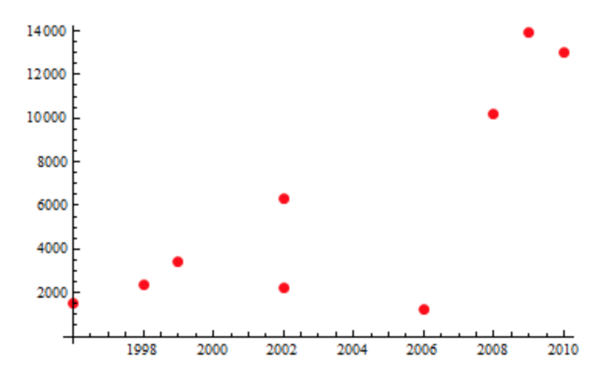
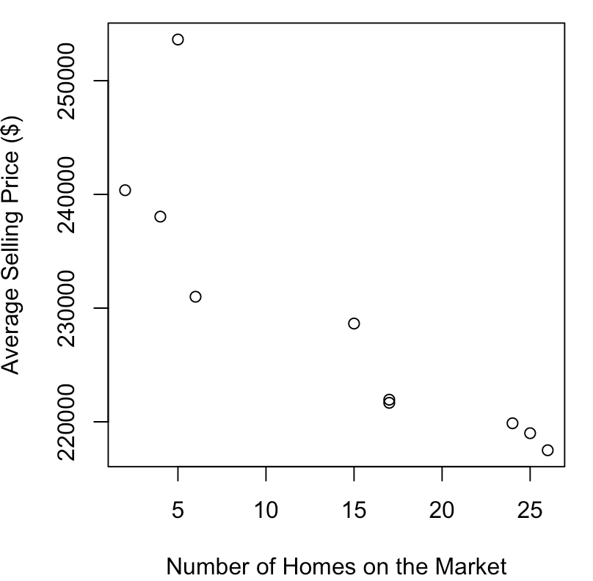
LCQ – Hypotheses
Problem: 1) Determine if it is appropriate to run a test on the Correlation and 2) State the Null and Alternative Hypotheses for each of the following scenarios.
a) You are interested in purchasing a new Honda Civic, so you collect a random sample of 9 Honda Civics being sold on Craiglist. Determine if there is a significant linear correlation between the model year of a Honda Civic being sold on Craigslist and its selling price. Use a 5% significance level.
b) A prospective homebuyer is trying to decide which neighborhood to move into. The real estate agent says that subdivisions with more houses for sale typically have homes for lower prices and provides a random sample of 10 neighborhoods with and all available listings. Determine if there is a significant negative linear correlation between number of homes on the market in a subdivision and average sale price at a 1% level of significance.

Slide 28




LCQ – Hypotheses
Problem: 1) Determine if it is appropriate to run a test on the Correlation and 2) State the Null and Alternative Hypotheses for each of the following scenarios.
You are interested in purchasing a new Honda Civic, so you collect a random sample of 9 Honda Civics being sold on Craiglist. Determine if there is a significant linear correlation between the model year of a Honda Civic being sold on Craigslist and its selling price. Use a 5% significance level.
1) Determine if appropriate
Scatterplot looks roughy linear, can run test on $ρ$ → Not a perfect linear relationship, but definitely enough to warrant a test! We are just mainly looking for the NOT curvature and any slight signs of linear
2) Hypotheses
H₀: ⍴ = 0 → ALWAYS start with NO linear correlation, so = 0. This of course means starting with the assumption of NO linear relationship, and then trying to show otherwise
H_{A}: ⍴ ≠ 0 → In the underlined wording, there was no indication whether we were trying to show a positive or negative correlation. We just wanted there to be some correlation.
This is similar-ish wording to trying to show the average is different than 50 (we don’t care if µ is above or below, just not equal to 50)
Except now with correlation, our “benchmark” is zero, which is kind of an absence of correlation. So showing that there IS a significant correlation means not equal to zero

Slide 29


LCQ – Hypotheses
Problem: 1) Determine if it is appropriate to run a test on the Correlation and 2) State the Null and Alternative Hypotheses for each of the following scenarios.
b) A prospective homebuyer is trying to decide which neighborhood to move into. The real estate agent says that subdivisions with more houses for sale typically have homes for lower prices and provides a random sample of 10 neighborhoods with and all available listings. Determine if there is a significant negative linear correlation between number of homes on the market in a subdivision and average sale price at a 1% level of significance.
1) Determine if appropriate
Scatterplot looks linear, can run test on $ρ$ → the outlier in the upper left maybe throws off the pattern, but definitely worth running the test for linearity
2) Hypotheses
H₀: ⍴ = 0 → ALWAYS start with NO linear correlation, so rho = 0
H_{A}: ⍴ < 0 → In the underlined wording here, there IS an indication that we want a NEGATIVE correlation! So not only do we want a significant correlation, we want rho to be less than zero
We could also get this from the previous beliefs italicized in the wording. The real estate agent believes that neighborhoods with MORE houses available sell for LESS on average
So our X is increasing and our Y is decreasing! These are moving in opposite directions → NEGATIVE association

Slide 30


Rejection Region
Rejection Region for Test on Correlation
This will actually be based on the t-distribution again!
But now we have new degrees of freedom! df = n – 2
This is because we have two variables now!
So all of our Critical Values will be t*s with the new df!
Using calc:
Left-Tailed: t* = invT(area =𝛼$,df=n−2$)
Right-Tailed: t* = invT(area = $1−α,df=n−\text{2}\text{)}$
Two-Tailed: t* = invT(area =$\frac{α}{2},df=n−\text{2}\text{)}$
Degrees of freedom from days past
Before with means we had: CV = t* with df = n - 1 (sample size – 1)

Slide 31




Test Statistic and P-value
Test Statistic
The Test Statistic t_{stat} has the following formula:
The sign of the correlation will ALWAYS match the sign of the Test Statistic!
Logic
Every bivariate (two variable) sample has a correlation r → this is our statistic, just like $\overline{x}$ or $\hat{p}$
We are implicitly comparing this to our parameter with the null value: $r −ρ$, where we start with ⍴ = 0 (just like $\overline{x}$ - µ or $\hat{p}$ - p)
So we standardize this, which is mainly taking into account the sample size!
With small samples, the correlation is VERY UNSTABLE (sensitive to small changes in the data), just like we saw in the outliers demo
So by standardizing, we can tell if the correlation is strong enough given the amount of data to conclude if there is really an underlying linear relationship between X and Y
P-Value
The p-value is the probability of getting our Test Statistic or more extreme, depending on the alternative hypothesis
Stronger sample correlations (further from zero) will result in smaller p-values!
Decisions
We can make our decisions to Reject or Fail to Reject using both the traditional method and the p-value method!
Example
r = -0.35
|
t_{stat} = -1.2
df = n - 2
-3 -2 -1 0 1 2 3
⍴
t df = n - 2
Standardize

Slide 32


Using Calc – Test on Correlation Coefficient
Setup: a) Determine if there is a significant linear correlation between the model year of a Honda Civic being sold on Craigslist and its selling price. Use a 5% significance level.
GOAL: Conduct a Test on the Correlation Coefficient!
Enter data
X data in L₁
Y data in L₂
LinRegTTest
Xlist = L₁
Ylist = L₂
Freq = 1
$β \& ρ$ = Alternative Hypothesis ***
RegEQ: Leave blank for now
Calculate
X Y
Setup: b) Determine if there is a significant negative linear correlation between number of homes on the market in a subdivision and average sale price at a 1% level of significance.
*** Alternative Hypothesis in Calc
$ρ$ is the correlation between the X and Y values in the population
𝛽 is the true slope of our best line if we had population data
Recall the correlation will always have the same sign as our slope!
X
Y
** Data table organization
Whenever data is presented in a table like it is here, generally speaking:
For Vertical tables, the X variable will be on the left and Y on the right
For Horizontal tables, the X will be the top and Y the bottom

Slide 33



Using Calc – Test on Correlation Coefficient
Setup: a) Determine if there is a significant linear correlation between the model year of a Honda Civic being sold on Craigslist and its selling price. Use a 5% significance level.
GOAL: Conduct a Test on the Correlation Coefficient!
Enter data
X data in L₁
Y data in L₂
LinRegTTest
Xlist = L₁
Ylist = L₂
Freq = 1
$β \& ρ$ = Alternative Hypothesis ***
RegEQ: Leave blank for now
Calculate
X Y
Calc Output we want
$β \& ρ$ = Alternative hypothesis
t = t_{stat} (Test Statistic)
p = p-value
df = degrees of freedom (n – 2)
r = sample correlation
*** Alternative Hypothesis in Calc
$ρ$ is the correlation between the X and Y values in the population
𝛽 is the true slope of our best line if we had population data
Recall the correlation will always have the same sign as our slope!
H₀: ⍴ = 0
H_{A}: ⍴ ≠ 0
** Data table organization
Whenever data is presented in a table like it is here, generally speaking:
For Vertical tables, the X variable will be on the left and Y on the right
For Horizontal tables, the X will be the top and Y the bottom

Slide 34




Using Calc – Test on Correlation Coefficient
Setup: b) Determine if there is a significant negative linear correlation between number of homes on the market in a subdivision and average sale price at a 1% level of significance.
GOAL: Conduct a Test on the Correlation Coefficient!
Enter data
X data in L₁
Y data in L₂
LinRegTTest
Xlist = L₁
Ylist = L₂
Freq = 1
$β \& ρ$ = Alternative Hypothesis ***
RegEQ: Leave blank for now
Calculate
X
Y
*** Alternative Hypothesis in Calc
$ρ$ is the correlation between the X and Y values in the population
𝛽 is the true slope of our best line if we had population data
Recall the correlation will always have the same sign as our slope!
H₀: ⍴ = 0
H_{A}: ⍴ < 0
** Data table organization
Whenever data is presented in a table like it is here, generally speaking:
For Vertical tables, the X variable will be on the left and Y on the right
For Horizontal tables, the X will be the top and Y the bottom

Slide 35
LCQ – Conclusions and Interpretations
Problem: Write the conclusions and interpretations for the previous scenarios using our results.
a) Use the Traditional Method
Setup: a) Determine if there is a significant linear correlation between the model year of a Honda Civic being sold on Craigslist and its selling price. Use a 5% significance level.
b) Use the P-Value Method
Setup: b) Determine if there is a significant negative linear correlation between number of homes on the market in a subdivision and average sale price at a 1% level of significance.

Slide 36

LCQ – Conclusions and Interpretations
Problem: Write the conclusions and interpretations for the previous scenarios using our results.
a) Use the Traditional Method
Setup: a) Determine if there is a significant linear correlation between the model year of a Honda Civic being sold on Craigslist and its selling price. Use a 5% significance level. (Recall there was a sample size of n = 9)
Test Statistic
Traditional Method → Need to find Critical Value first !!
CV = t* = invT(area = 0.05/2, df = 9 – 2) = -2.365
→ TWO tailed test, so we have to split alpha in two and we know that we will be comparing the absolute values of or CV and TS!
Showing work for Test Statistic we did earlier
Entered X data in L₁ and Y data in L₂
TS = t_{stat} = LinRegTTest(Xlist = L₁, Ylist = L₂, Freq = 1, 𝛽 & ⍴ ≠ 0) = 6.842
df = 7
|t_{stat}| = 6.842 > 2.365 = |t*| → Reject H₀!
Conclusion and Interpretation
Since the absolute value of our TS t_{stat} = 6.82 is greater than the absolute value our CV t* = 2.365, we reject the null hypothesis.
We have sufficient evidence to conclude that there is a significant (positive) linear correlation between the model year of a Honda Civic and its selling price → PERFECT
Remember to put the values for the TS and CV in our conclusion, be specific!
Our alternative is that there is a significant linear correlation!! And it is between our two variables IN CONTEXT!!!!! Don’t just say X and Y
We could also say significant linear relationship, both would be correct!
Additionally, we can write the extra info that this is a positive linear relationship, which we know because the Test Statistic was positive (and the sample correlation = 0.933)
Hypotheses
H₀: ⍴ = 0
H_{A}: ⍴ ≠ 0

Slide 37
LCQ – Conclusions and Interpretations
Problem: Write the conclusions and interpretations for the previous scenarios using our results.
b) Use the P-Value Method
Setup: b) Determine if there is a significant negative linear correlation between number of homes on the market in a subdivision and average sale price at a 1% level of significance.
P-Value Method
Showing work for p-value we did earlier
Entered X data in L₁ and Y data in L₂
P-value = LinRegTTest(Xlist = L₁, Ylist = L₂, Freq = 1, 𝛽 & ⍴ < 0) ≈ 0
TS = t_{stat} = -4.888
df = 7
p-value ≈ 0 < 0.01 = 𝛼 → Reject H₀!
Conclusion and Interpretation
Since the p-value ≈ 0 is less than the significance level = 0.01, we reject the null hypothesis.
We have sufficient evidence to conclude that there is a significant negative linear correlation between the number of homes for sale in a neighborhood and the average selling price → PERFECT
Remember to put the values for the p-value and significance level, be specific!
Again, USE CONTEXT!!!!! Don’t just say X and Y
And negative linear relationship because of the negative TS and r = -0.866
Hypotheses
H₀: ⍴ = 0
H_{A}: ⍴ < 0
Really Small Probabilities
Remember what the notation our calculator uses for really small numbers!
P-value = 6.059 E-4
= 6.059 x 10⁻⁴
= 6.059/10000
= 0.0006059
≈ 0

Slide 38
Problem Session!!!

Slide 39

Example 1
The article “Effects of Gamma Radiation on Juvenile and Mature Cuttings of Quaking Aspen” (Forest Science [1967]: 240-245) reported data on x = exposure time to radiation and y = dry weight of roots.
Does there seem to be a positive association, a negative association, or no association?
Can the trend in the data points be approximated reasonably well by a straight line?

Slide 40


TV Watching and Birth Rate
The figure shows recent data on x = the number of TVs per 100 people and y = the birth rate (number of births per 1000 people) for 6 African and Asian nations. The regression line $\hat{y}=29.8−0.024x$ applies to the data for these six countries. For illustration, another point is added at (81, 15.2) which is the observation for the United States. The regression line for all 7 points is $\hat{y}=31.2−0.195x$.
Does the U.S. observation appear to be an outlier on x? an outlier on y? or both?
Agresti, A., & Franklin, C. (2013). Statistics: The Art and Science of Learning from Data, 3rd edition. Boston, MA: Pearson.

Slide 41

TV Watching and Birth Rate
The figure shows recent data on x = the number of TVs per 100 people and y = the birth rate (number of births per 1000 people) for 6 African and Asian nations. The regression line $\hat{y}=29.8−0.024x$ applies to the data for these six countries. For illustration, another point is added at (81, 15.2) which is the observation for the United States. The regression line for all 7 points is $\hat{y}=31.2−0.195x$.
Does the U.S. observation appear to be an outlier on x? an outlier on y? or both?
BOTH, very far in the X and Y from the rest of the data
Agresti, A., & Franklin, C. (2013). Statistics: The Art and Science of Learning from Data, 3rd edition. Boston, MA: Pearson.

Slide 42
TV Watching and Birth Rate, p.4
The correlation r = -0.051 without the U.S. but with the U.S., r = -0.935. Why you would conclude that the association between birth rate and number of TVs is very weak without the U.S. point and very strong with the U.S. point?

Slide 43
TV Watching and Birth Rate, p.5
The correlation r = -0.051 without the U.S. but with the U.S., r = -0.935. Why you would conclude that the association between birth rate and number of TVs is very weak without the U.S. point and very strong with the U.S. point?
The association is very weak w/o the U.S. because the 6 countries all have very few TVs. The association is very strong w/the U.S. because the U.S. is so much higher in #of TVs and so much lower on birth rate that it makes the 2 variables seem related.

Slide 44
Problem #3
The human resources department at a large multinational corporation wants to be able to predict average salary for a given number of years’ experience. Data on salary (in $1000s) and years of experience were collected for a sample of employees.
Which variable is the explanatory or predictor variable?
Which variable is the response variable?
Which variable would you plot on the y axis?

Slide 45
Problem #3 Solution
The human resources department at a large multinational corporation wants to be able to predict average salary for a given number of years’ experience. Data on salary (in $1000s) and years of experience were collected for a sample of employees.
Which variable is the explanatory or predictor variable? Years of experience
Which variable is the response variable? Salary
Which variable would you plot on the y axis? Salary

Slide 46

Problem #1
Consider the data from a small bookstore.
Prepare a scatterplot of Sales against Number of Sales People Working.
What can you say about the direction of the association?
What can you say about the form of the relationship?
What can you say about the strength of the relationship?
Does the scatterplot show any outliers?

Slide 47

Problem #1 Solution
There is a positive association between number of sales people working and sales.
The relationship appears to be linear.
The relationship appears to be strong.
The scatterplot does not appear to show any outliers.

Slide 48
Problem #7
A larger firm is considering acquiring the bookstore of Exercise 1. An analyst for the firm, noting the relationship see in Exercise 1, suggests that when they acquire the store they should hire more people because that will drive higher sales.
Is his conclusion justified?
What alternative explanations can you offer?

Slide 49
Problem #7 Solution
Correlation does not imply causation. The analysts argument is that sales staff cause sales. However, the data may reflect the store hiring more people as sales increase, so any causation would run the other way.

Slide 50

Problem #25
Which of the scatterplots show:
Little or no association?
A negative association?
A linear association?
A moderately strong association?
A very strong association?

Slide 51
Problem #25 Solution
Which of the scatterplots show:
Little or no association? none
A negative association? 3 and 4
A linear association? 2, 3, and 4
A moderately strong association? 2 and 4
A very strong association? 1 and 3

Slide 52
Problem #29
Match the scatterplots to the correlation coefficients. The calculated correlation coefficients are:
-0.923
-0.487
0.006
0.777

Slide 53
Problem #29 Solution
Match the scatterplots to the correlation coefficients. The calculated correlation coefficients are:
-0.923 matches Graph 3
-0.487 matches Graph 4
0.006 matches Graph 1
0.777 matches Graph 2

